Slide 1
Introduction to C++

Slide 2
C++ Programming
C++ is a multi-paradigm programming language that supports object-oriented programming (OOP), created by Bjarne Stroustrup in 1983 at Bell Labs, C++ is an extension(superset) of C programming and the programs are written in C language can run in C++ compilers.
C++ supports object-oriented programming (OOP), with four significant principles of object-oriented development:
Abstraction
Encapsulation
Inheritance
Polymorphism

Slide 3
Main Features of C++
The main focus remains on data rather than procedures.
Object-oriented programs are segmented into parts called objects.
Data structures are designed to categorize the objects.
Data member and functions are tied together as a data structure.
Data can be hidden and cannot be accessed by external functions using access specifier.
Objects can communicate among themselves using functions.
New data and functions can be easily added anywhere within a program whenever required.
Since this is an object-oriented programming language, it follows a bottom up approach.

Slide 4
A C++ program
//include headers; these are modules that include functions that you may use in your program; we will almost always need to include the header that defines cin and cout; the header is called iostream.h
#include <iostream.h>
int main() {
//variable declaration
//read values input from user
//computation and print output to user
return 0;
}
After you write a C++ program you compile it; that is, you run a program called compiler that checks whether the program follows the C++ syntax
  if it finds errors, it lists them
  If there are no errors, it translates the C++ program into a program in machine language which you can execute

Slide 5
Hello world program
#include <iostream>
using namespace std;
int main()
{
cout<<"Hello World!";
return 0;
}

Slide 6
Namespace in C++
Namespace is a feature added in C++ and not present in C.
Namespaces allow us to group named entities that otherwise would have global scope into narrower scopes, giving them namespace scope. This allows organizing the elements of programs into different logical scopes referred to by names.
A namespace is a declarative region that provides a scope to the identifiers (names of the types, function, variables etc) inside it.
Multiple namespace blocks with the same name are allowed. All declarations within those blocks are declared in the named scope.
namespace namespace_name
{
int x, y; // code declarations
}

Slide 7
Namespace in C++
#include <iostream>
int main()
{
std::cout << "Hello world;
return 0;
}
#include <iostream>
using namespace std;
int main()
{
cout << "Hello world!";
return 0;
}
Example 1
Example 2

Slide 8
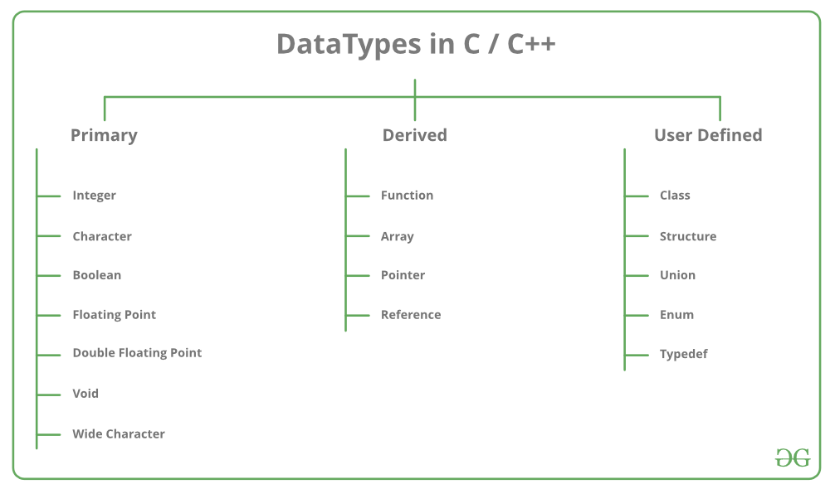

C++ Data Types

Slide 9
Modifiers in C++
Data type modifiers available in C++ are:
  Signed
  Unsigned
  Short
  Long

Slide 10
DATA TYPE | SIZE (IN BYTES) | RANGE
short int | 2 | -32,768 to 32,767
unsigned short int | 2 | 0 to 65,535
unsigned int | 4 | 0 to 4,294,967,295
int | 4 | -2,147,483,648 to 2,147,483,647
long int | 4 | -2,147,483,648 to 2,147,483,647
unsigned long int | 4 | 0 to 4,294,967,295
long long int | 8 | -(2^63) to (2^63)-1
unsigned long long int | 8 | 0 to 18,446,744,073,709,551,615
signed char | 1 | -128 to 127
unsigned char | 1 | 0 to 255
float | 4
double | 8
long double | 12
wchar_t | 2 or 4 | 1 wide character
Note : Above values may vary from compiler to compiler. In above example, we have considered GCC 64 bit.

Slide 11
Variable declaration
type variable-name;
Meaning: variable <variable-name> will be a variable of type <type>
Example:
int a, b, c;
double x;
int sum;
char my-character;

Slide 12
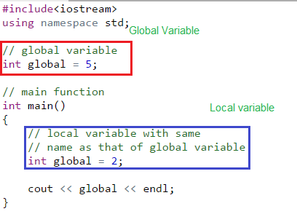
Scope of Variables
Local Variables
Global Variables
Note : To access global variable when there is a local variable with same name , the scope resolution operator.(::) - cout<<::global;

Slide 13
Constant and Literals
we can define constants in two ways as shown below:
#define preprocessor directive
const keyword
#include <iostream>
using namespace std;
#define val 10
int main() {
const int intVal = 10;
cout << "Integer Constant: " << val << "\n";
cout << "Integer Constant: " << intVal << "\n";
return 0;
}

Slide 14
Basic Input / Output in C++
In C++ input and output is performed in the form of a sequence of bytes or more commonly known as streams.
Input Stream: If the direction of flow of bytes is from the device(for example, Keyboard) to the main memory then this process is called input.
Output Stream: If the direction of flow of bytes is opposite, i.e. from main memory to device( display screen ) then this process is called output.

Slide 15
Header files – for Input/Output Operations
iostream: iostream stands for standard input-output stream. This header file contains definitions to objects like cin, cout, cerr etc.
iomanip: iomanip stands for input output manipulators. The methods declared in this files are used for manipulating streams. This file contains definitions of setw, setprecision etc.
fstream: This header file mainly describes the file stream. This header file is used to handle the data being read from a file as input or data being written into the file as output.

Slide 16
iostream
The two keywords cout and cin are used very often for printing outputs and taking inputs respectively.
Standard output stream (cout): Usually the standard output device is the display screen. It is the instance of the ostream class. The data needed to be displayed on the screen is inserted in the standard output stream (cout) using the insertion operator(<<).
standard input stream (cin): cin statement is the instance of the class istream. and is used to read input from the standard input device which is usually a keyboard.
The extraction operator(>>) is used along with the object cin for reading inputs.

Slide 17
Input statements
cin >> variable-name;
Meaning: read the value of the variable called <variable-name> from the user
Example:
cin >> a;
cin >> b >> c;
cin >> x;
cin >> my-character;

Slide 18
Output statements
cout << variable-name;
Meaning: print the value of variable <variable-name> to the user
cout << “any message “;
Meaning: print the message within quotes to the user
cout << endl;
Meaning: print a new line
Example:
cout << a;
cout << b << c;
cout << “This is my character: “ << my-character << “ he he he” << endl;

Slide 19
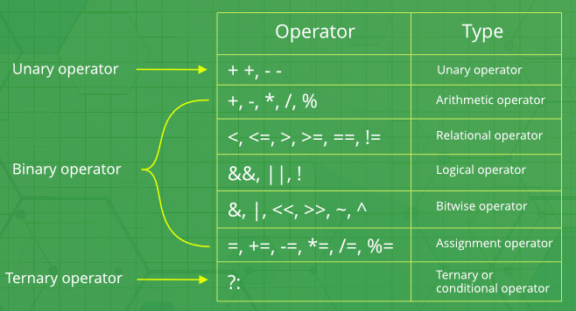
Operators in C++
Operators --- sizeof(), comma

Slide 20
Additional in C++
Scope Resolution Operator (::)
Pointer to member declarator (::*)
Pointer to member operator(->*)
Pointer to member operator(.*)
delete – memory deallocate
new – memory allocate
setw – field width operator

Slide 21
Functions
Block of code executed when called.
Two types
  Predefined
  User defined
Function declaration
Function definition
Function call

Slide 22
Function Example
#include <iostream> using namespace std;
int main()
{
int a,b;
void swap(int a, int b) {
and b are formal parameters
b = a + b; a = b - a;
b = b - a;
cout<<"\nAfter swapping: "; cout<<"a = "<<a;
cout<<"\tb = "<<b;
return;
}
//here a
cout<<"Enter the two numbers to be swapped: ";
cin>>a>>b;
cout<<"a = "<<a; cout<<"\tb = "<<b;
swap(a,b);
}
Output:
//here a and b are actual parameters
Enter the two numbers to be swapped: 5 3 a = 5 b = 3
After swapping: a = 3 b = 5

Slide 23
Formal And Actual Parameters
The parameters that are defined in the function definition are called Formal Parameters.
The parameters in the function call which are the actual values are called Actual Parameters.

Slide 24
Passing Parameters To Functions
Pass by Value
Pass by Reference
Pass by Pointer

Slide 25
Pass by value
#include <iostream> using namespace std; void swap(int a, int b)
{
//here a and b are formal parameters b = a + b;
a = b - a;
b = b - a;
cout<<"\nAfter swapping inside Swap:\n "; cout<<"a = "<<a;
cout<<"\tb = "<<b; return;
}
int main()
{
int a,b;
cout<<"Enter the two numbers to be swapped: "; cin>>a>>b;
cout<<"a = "<<a; cout<<"\tb = "<<b; swap(a,b);
cout<<"\nAfter swapping inside Main:\n "; cout<<"a = "<<a;
cout<<"\tb = "<<b;
}

Slide 26
Pass by reference
#include <iostream> #include <string>
int main()
{
int a,b;
cout<<"Enter the two numbers to be swapped: "; cin>>a>>b;
cout<<"a = "<<a; cout<<"\tb = "<<b; swap(a,b);
cout<<"\nAfter swapping inside Main:\n ";
cout<<"a = "<<a;
cout<<"\tb = "<<b;
using namespace std;
void swap(int &a, int &b)
{
int temp = a;
a = b;
b = temp;
}
}

Slide 27
Pass by Pointer
#include <iostream> #include <string> using namespace std;
void swap(int *a, int *b)
{
int temp = *a;
*a = *b;
*b = temp;
}
int main()
{
int a,b;
cout<<"Enter the two numbers to be swapped: "; cin>>a>>b;
cout<<"a = "<<a; cout<<"\tb = "<<b; swap(a,b);
cout<<"\nAfter swapping inside Main:\n "; cout<<"a = "<<a;
cout<<"\tb = "<<b;
}

Slide 28
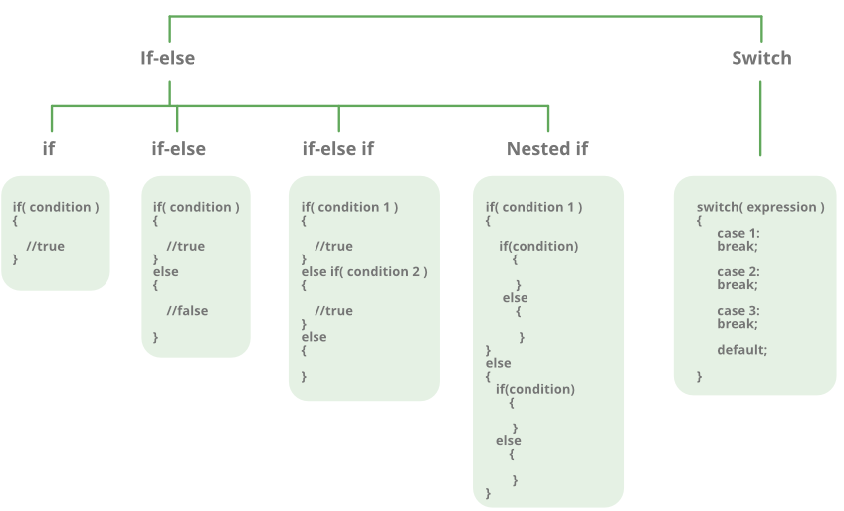
Decision Making

Slide 29
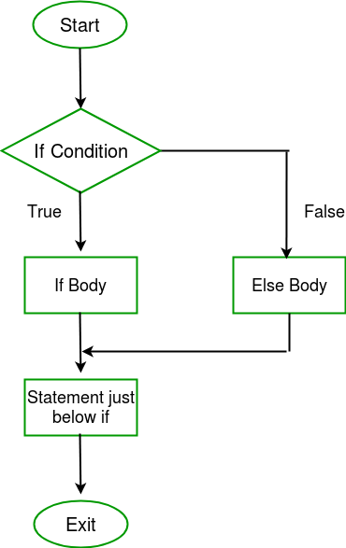
If statement
if (condition) {
  S1;
  }
  else {
  S2;
  }
  S3;

Slide 30
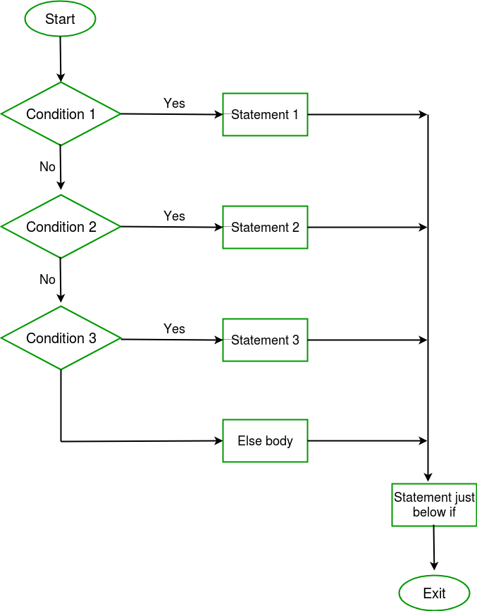
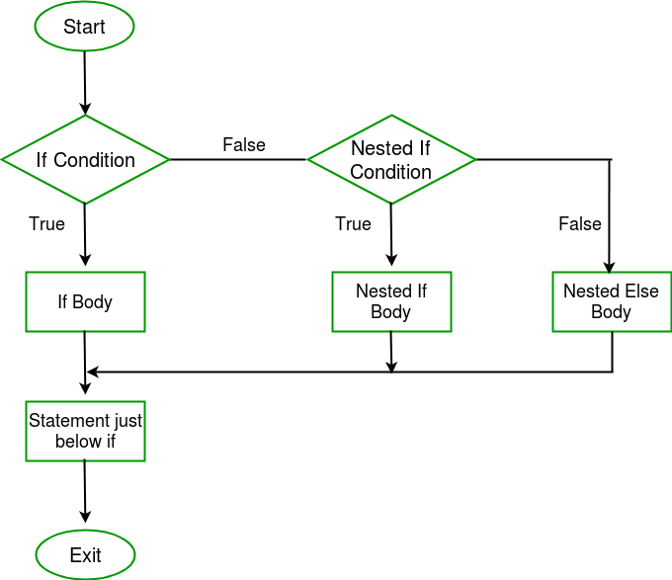
If Statement – Nested and ladder

Slide 31
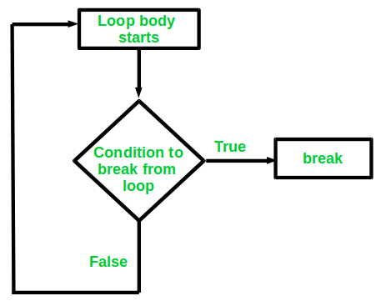
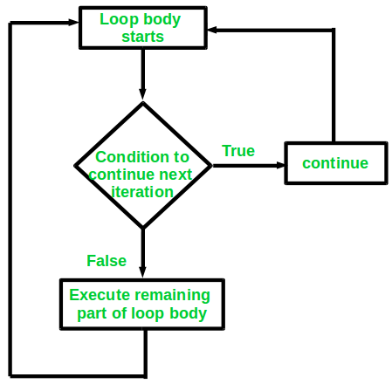
Jump Statements
Break
Continue

Slide 32
Boolean conditions
..are built using
Comparison operators
  == equal
  != not equal
  < less than
  > greater than
  <= less than or equal
  >= greater than or equal
Boolean operators
  && and
  || or
  ! not

Slide 33
Examples
Assume we declared the following variables:
int a = 2, b=5, c=10;
Here are some examples of boolean conditions we can use:
if (a == b) …
if (a != b) …
if (a <= b+c) …
if(a <= b) && (b <= c) …
if !((a < b) && (b<c)) …

Slide 34
If example
Example 1: Find Largest Number Using if Statement
#include <iostream>
using namespace std;
int main()
{
float n1, n2, n3;
cout << "Enter three numbers: ";
cin >> n1 >> n2 >> n3;
if (n1 >= n2)
{
if (n1 >= n3)
cout << "Largest number: " << n1;
else
cout << "Largest number: " << n3;
}
else
{
if (n2 >= n3)
cout << "Largest number: " << n2;
else
cout << "Largest number: " << n3;
}
return 0;
}

Slide 35
Switch statement
Simple Calculator using switch statement
# include <iostream>
using namespace std;
int main()
{
char op;
float num1, num2;
cout << "Enter operator either + or - or * or /: ";
cin >> op;
cout << "Enter two operands: ";
cin >> num1 >> num2;
switch(op)
{
case '+':
cout << num1+num2;break;
case '-':
cout << num1-num2;break;
case '*':
cout << num1*num2;break;
case '/':
cout << num1/num2;break;
default:
cout << "Error! operator is not correct"; break;
}
return 0;
}

Slide 36
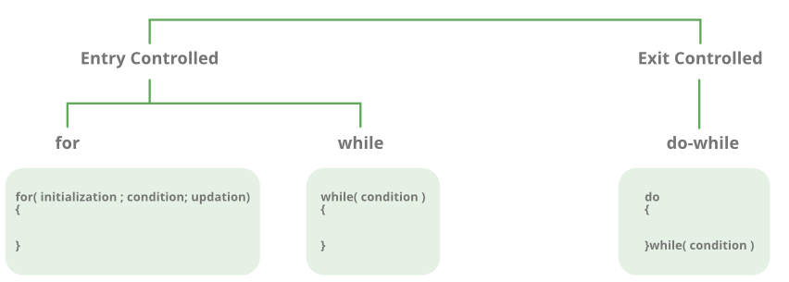
Loops

Slide 37
For loop
for (initialization expr; test expr; update expr)
{ // body of the loop // statements we want to execute }

Slide 38
For loop example
// C++ program to illustrate for loop
#include <iostream>
using namespace std;
int main()
{
for (int i = 1; i <= 10; i++)
{
cout << "Hello World\n";
}
return 0;
}

Slide 39
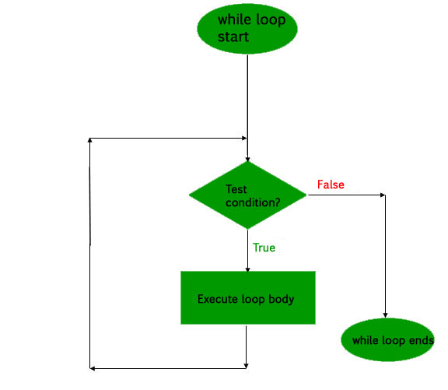
While statements
while (condition) {
S1;
}
S2;

Slide 40
While example
//read 10 numbers from the user and output their sum
#include <iostream>
using namespace std;
void main() {
int i, sum, x;
sum=0;
i=1;
while (i <= 10) {
cin >> x;
sum = sum + x;
i = i+1;
}
cout << “sum is “ << sum << endl;
}

Slide 41
Do - while loop
/ C++ program to add numbers until user enters 0
#include <iostream>
using namespace std;
int main()
{
float number, sum = 0.0;
do {
cout<<"Enter a number: ";
cin>>number;
sum += number;
}
while(number != 0.0);
cout<<"Total sum = "<<sum;
return 0;
}

Slide 42
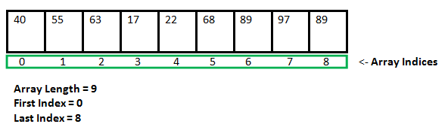
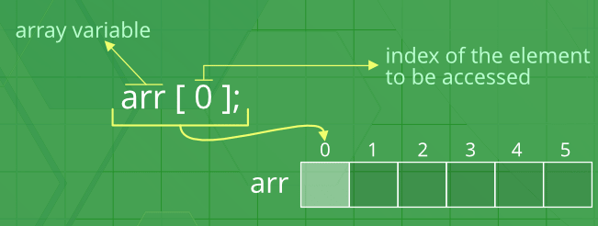
Array in C++
An array in C++ is a collection of items stored at contiguous memory locations and elements can be accessed randomly using indices of an array.
They are used to store similar type of elements as in the data type must be the same for all elements.

Slide 43
The elements are stored at contiguous memory locations
#include <iostream>
using namespace std;
int main()
{
int arr[5], i;
cout << "Size of integer in this compiler is " << sizeof(int) << "\n";
for (i = 0; i < 5; i++)
cout << "Address arr[" << i << "] is " << &arr[i] << "\n";
return 0;
}

Slide 44
Arrays
C++ program to store and calculate the sum of 5 numbers entered by the user using arrays.
#include <iostream>
using namespace std;
int main()
{
int numbers[5], sum = 0;
cout << "Enter 5 numbers: ";
for (int i = 0; i < 5; ++i)
{
cin >> numbers[i];
sum += numbers[i];
}
cout << "Sum = " << sum << endl;
return 0;
}

Slide 45
Access specifiers:
In C++, there are three access specifiers:
public - members are accessible from outside the class
private - members cannot be accessed (or viewed) from outside the class
protected - members cannot be accessed from outside the class, however, they can be accessed in inherited classes.

